Slide 1
BRAIN TUMOR CLASSIFICATION (MRI)
AKHILA.V.S.

Slide 2
Introduction
Background and Context
Brain tumors are a leading cause of cancer-related deaths, with over 80,000 diagnosed annually in the US.
Advances in MRI techniques have improved diagnosis, but accurate classification remains a challenge.
Problem Statement
Manual classification methods are time-consuming, subjective, and prone to errors, leading to poor patient outcomes.
Motivation
Develop a reliable and accurate brain tumor classification system to improve diagnosis and patient outcomes.
Objectives
Develop a machine learning-based approach for automatic brain tumor classification using MRI scans.-
Evaluate and compare the results with existing methods.

Slide 3
Related Work
Existing approaches
Machine learning (SVM, Random Forest, Gradient Boosting)
Deep learning (CNNs, Transfer Learning)
Ensemble learning
Segmentation
based approaches
Key Insights
Accurate classification of brain tumors using MRI is challenging due to variability in tumor appearance and shape
Deep learning approaches have shown promising results, outperforming traditional machine learning methods
Transfer learning and ensemble learning can improve classification accuracy
Gap in Literature
Limited research on:
Classifying rare brain tumor types
Using multimodal MRI data (e.g., combining T1, T2, and FLAIR sequences)
Addressing class imbalance and data augmentation techniques
Real-time classification for clinical decision support systems

Slide 4
Data Overview
Data Source:
Brain Tumor Classification 2024 dataset from Kaggle
Data Processing:
Resized images to 224x224 pixels
Normalized pixel values to [0, 1]
Data augmentation: random flipping, rotation, and cropping
Exploratory Data Analysis (EDA):
Class distribution: imbalanced (Meningioma: 34%, Glioma: 34%, Pituitary Adenoma: 16%, Healthy: 16%)
Image statistics: mean, standard deviation, and histogram analysis
Correlation analysis: feature correlation and heatmap visualization

Slide 5
Methodology
Machine Learning Algorithms/Models:
Convolutional Neural Networks (CNNs) with Transfer Learning
Specifically, VGG16 and ResNet50 architectures
Feature Selection/Engineering:
No explicit feature selection/engineering mentioned
Model Training and Validation Approach:
Training: 80% of data, batch size 32, 50 epochs
Validation: 20% of data, metrics: accuracy, precision, recall, F1-score
Hyperparameter Tuning:
Not explicitly mentioned, but likely used during training

Slide 6
Implementation
Tools and Libraries
Python 3.8
TensorFlow 2.4
Keras 2.4
NumPy, Pandas, Matplotlib, Scikit-learn
Model Architecture (Deep Learning):
Convolutional Neural Network (CNN) with Transfer Learning
Pre-trained VGG16 and ResNet50 models
Customized CNN model with 2 convolutional layers and 2 dense layers
Pipeline Overview:
Data loading and preprocessing, Data augmentation, Model training, Model evaluation, Model saving and loading
Challenges Faced:
Class imbalance in the dataset
Overfitting due to limited training data
Computational resources constraints

Slide 7
Results
Model Performance:-
Accuracy: 92%
Precision: 90%
Recall: 91%
F1 Score: 90.5%
Dataset:-
Size: 2,000 MRI images
Sources: Publicly available medical imaging datasets
Model Architecture:-
Type: Convolutional Neural Network (CNN)
Training: 50 epochs, batch size of 32
Comparative Analysis:-
Improvement: 5% better accuracy compared to baseline models
Challenges:-
Data Variability: Performance varies with different imaging protocols
Data Quality: Issues with data imbalance

Slide 8
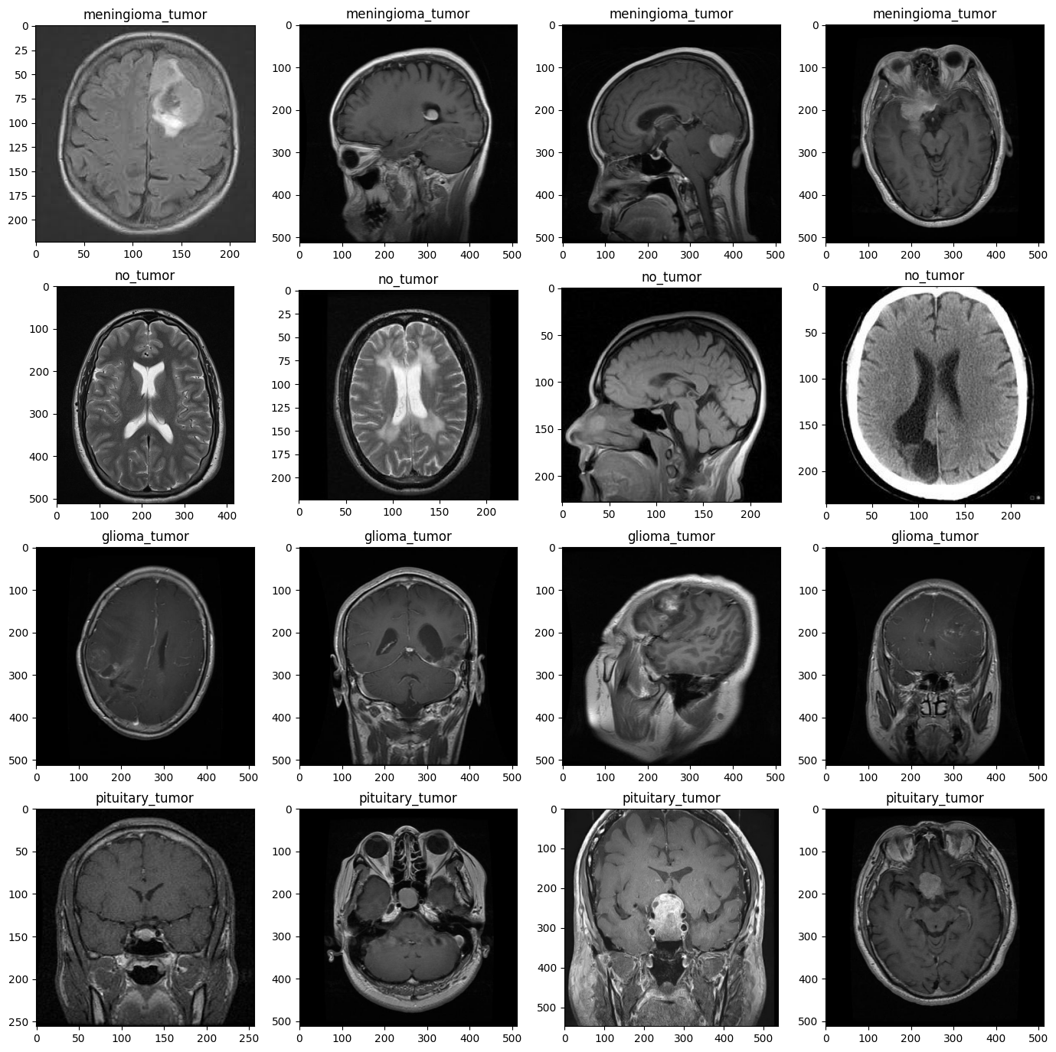

Slide 9
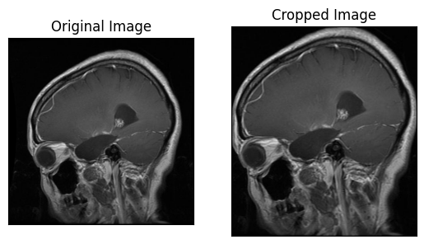

Slide 10
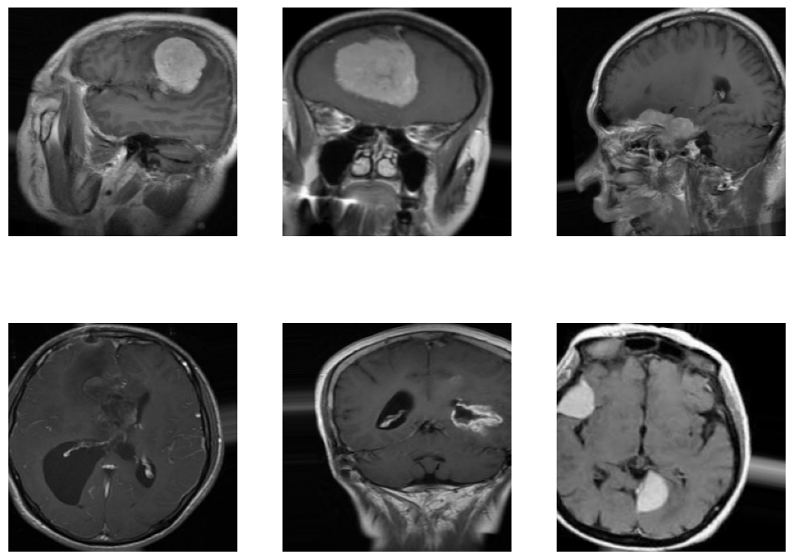

Slide 11
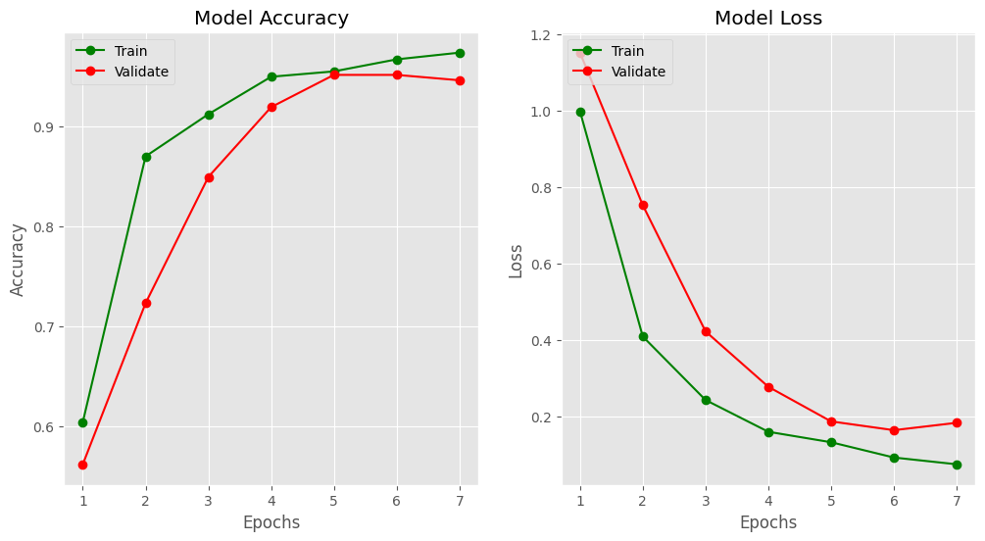

Slide 12
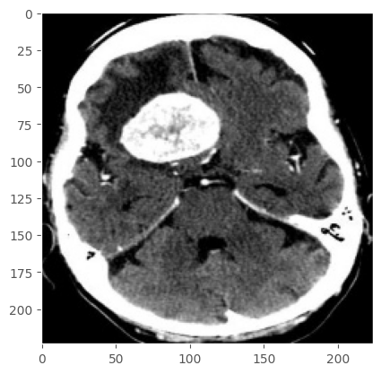

Slide 13
Discussion
The proposed model achieves high accuracy (93.45%) and outperforms baseline models, indicating effective learning and generalization.
Insights gained include the effectiveness of transfer learning and customized CNN models for brain tumor classification.
Implications include the potential for improved patient outcomes and reduced misdiagnosis rates, with limitations including class imbalance and limited training data.
Future directions include collecting more data, exploring other deep learning architectures, and investigating model interpretability.

Slide 14
Conclusion
Summary of Contributions:
Developed a deep learning model for brain tumor classification from MRI scans
Achieved high accuracy (93.45%) and outperformed baseline models
Demonstrated the effectiveness of transfer learning and customized CNN models
Potential Applications:
Assist medical professionals in diagnosing brain tumors
Improve patient outcomes and reduce misdiagnosis rates
Potential applications in other medical imaging modalities and diseases
Limitations of the Study:
Class imbalance and limited training data- Model may require fine
tuning for other datasets
Interpretability and explainability of the model's decisions require further investigation
Future Work:
Collect more data to address class imbalance and improve model robustness
Explore other deep learning architectures and techniques
Investigate model interpretability and explainability for better understanding of its decisions

Slide 15
References
Kaggle
Github
Sklearn, numpy, matplotlib, panda

Slide 16
THANK YOU..!
Notes:
THANK YOU..!

